Slide 1


Project:EEM-16
13. Project Fair and Competition(2020)
Engineering Faculty
DESIGN AND IMPLEMENTATION OF AUTOMATED LOW-COST DOUBLE AXIS SOLAR TRACKING SYSTEM
Gökberk Batuhan Duran
Ufuk Can Özlen
Hacı Ali Sayar
Burçin Yiğit
Department:Electrical and Electronics Engineering
Advisor:Assoc.Prof.Dr. ÜMMÜHAN BAŞARAN FİLİK

Slide 2

Project: EEM-16
Solar Panel
Engineering Faculty
Electrical devices that produce electrical energy from sunlight using semiconductors are called solar cells. Solar panels are created by combining multiple cells.

Slide 3
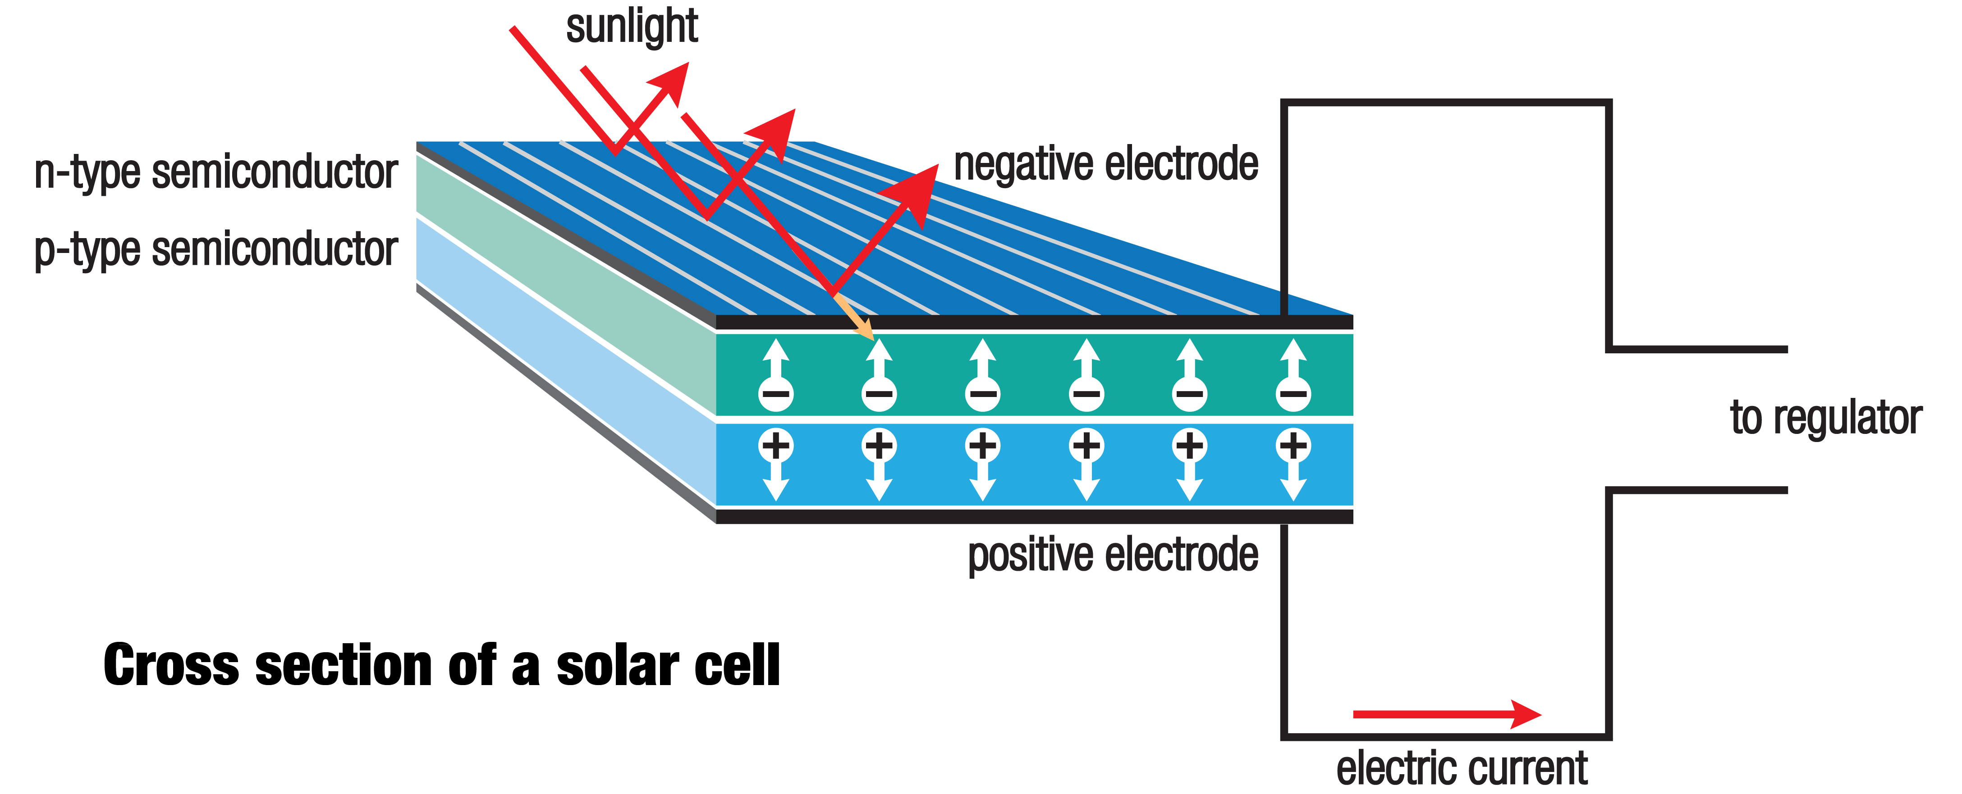
Project : EEM-16
Solar Panel
Engineering Faculty
Figure 1: Producing Current and Semiconductor

Slide 4
Project : EEM-16
The Produced Energy by Solar Panels
Engineering Faculty
The energy produced by solar panels depends on
Solar panels temperature-ambient temperature
Solar irradiance
Tilt angle of sunlight
Shadows on the panel
Cleaning of the solar panels.

Slide 5
Project : EEM-16
Solar Tracker
Engineering Faculty
Systems that can track the movement of the sun during the day are called solar trackers. Solar trackers can follow the sun on one axis or two axes. To achieve maximum power, it is necessary to design followers on two axes.

Slide 6
Project : EEM-16
Dual Axis Solar Tracker
Engineering Faculty
Systems that track the sun in two directions using various equipment are called dual axis solar trackers. Dual axis solar tracker can be designed by using light dependent resistor, GPS etc. equipment.

Slide 7
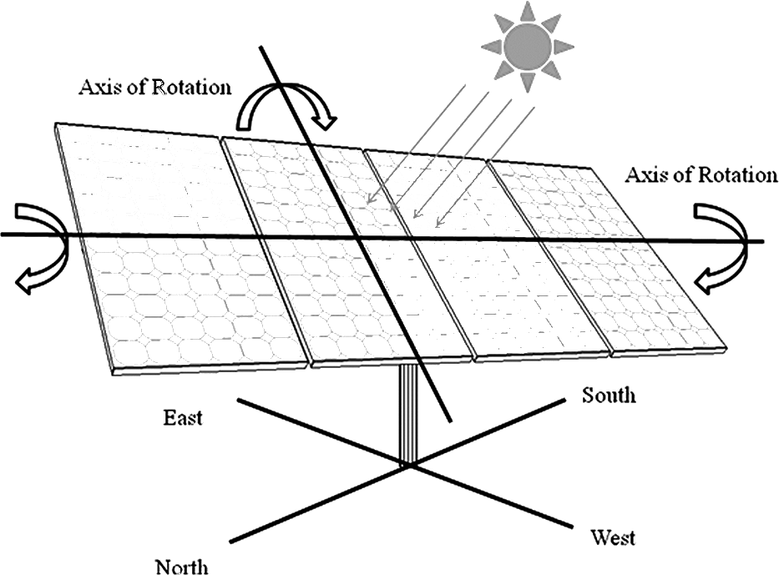
Project : EEM-16
Dual Axis Solar Tracker
Engineering Faculty
Figure 2 : Direction of Solar Panel

Slide 8
Project : EEM-16
The Differences of Design
Engineering Faculty
Features that distinguish this design from other projects
designing the system using simulation programs
designing the system at low cost

Slide 9
Project : EEM-16
Equipment Used In Project
Engineering Faculty
Equipment used in our design
Light dependent resistor(LDR)
Arduino
Direct current motor
Motor driver

Slide 10
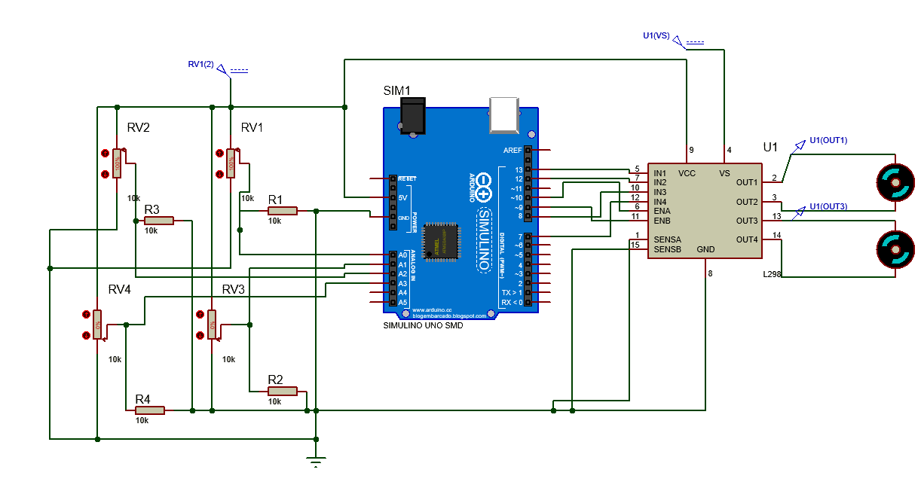
Project : EEM-16
Equipment Used In Project
Engineering Faculty
Figure 3 : System on Proteus

Slide 11
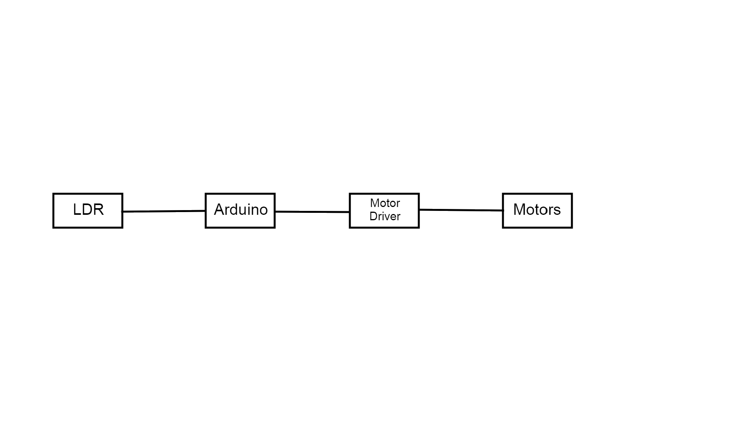
Project : EEM-16
Block Diagram
Engineering Faculty

Slide 12
Project : EEM-16
Light Dependent Resistor
Engineering Faculty
An LDR or light dependent resistor is also known as photo resistor, photocell, photoconductor. It is a one type of resistor whose resistance varies depending on the amount of light falling on its surface.

Slide 13
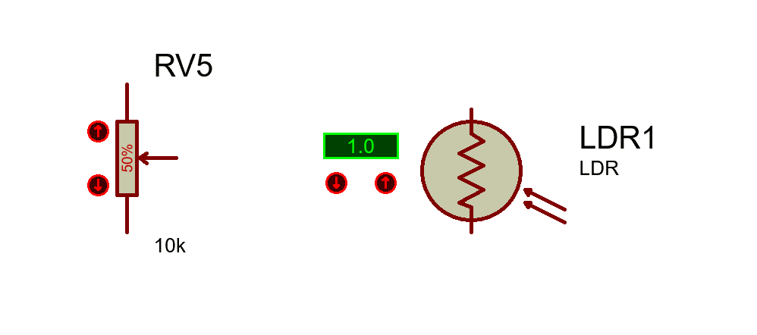
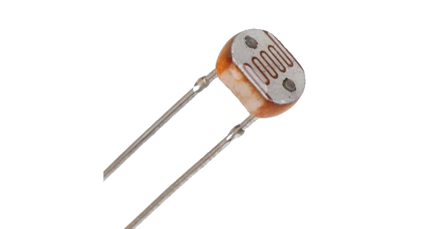
Project : EEM-16
Light Dependent Resistor
Engineering Faculty
Figure 4 : LDR and LDR in Proteus

Slide 14
Project : EEM-16
Arduino
Engineering Faculty
The electronic card with an Atmel AVR microcontroller and equipment that provides communication with the external environment is called Arduino. Data can be received with various sensors and electronic parts can be controlled with output pins.

Slide 15
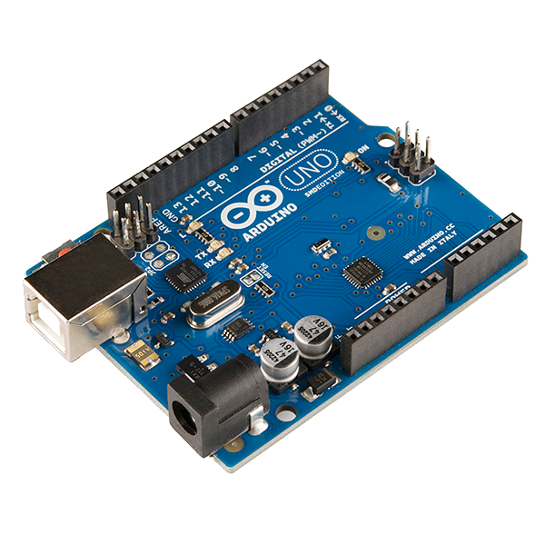
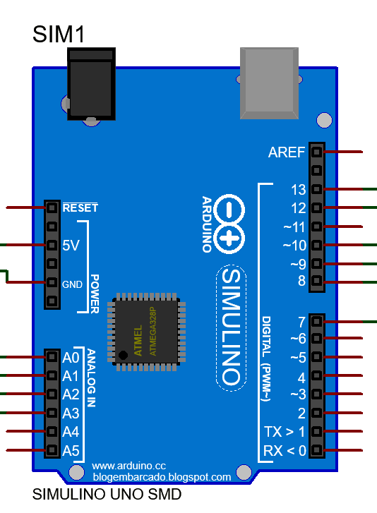
Project : EEM-16
Arduino
Engineering Faculty
Figure 5 : Arduino and Arduino in Proteus

Slide 16
Project : EEM-16
Direct Current Motor
Engineering Faculty
DC motor is the machine that converts direct current into mechanical energy. When electric current is applied to the windings inside the motor, the magnetic force formed in the opposite direction to the permanent magnets inside the motor and the motor rotates.

Slide 17
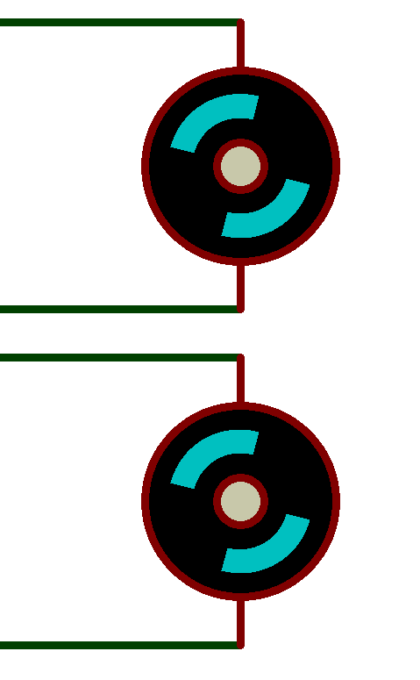
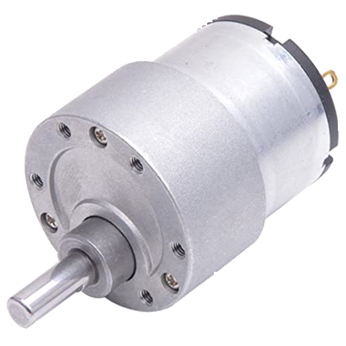
Project : EEM-16
Direct Current Motor
Engineering Faculty
Figure 6 : DC Motor and DC Motor in Proteus

Slide 18
Project : EEM-16
Motor Driver
Engineering Faculty
The electrical part that controls the motor direction and speed according to the signals coming from the microprocessor is called the motor driver.

Slide 19
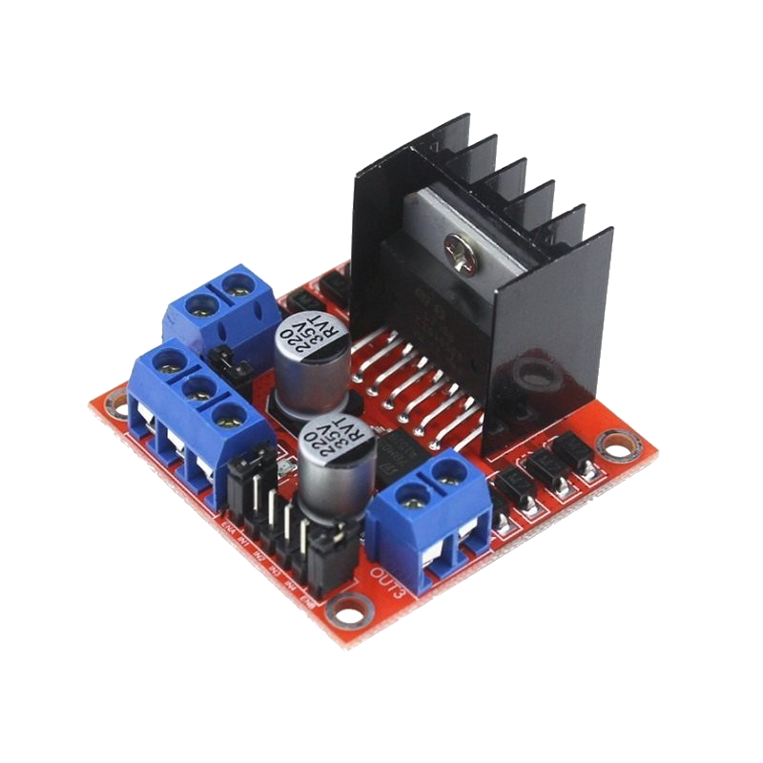
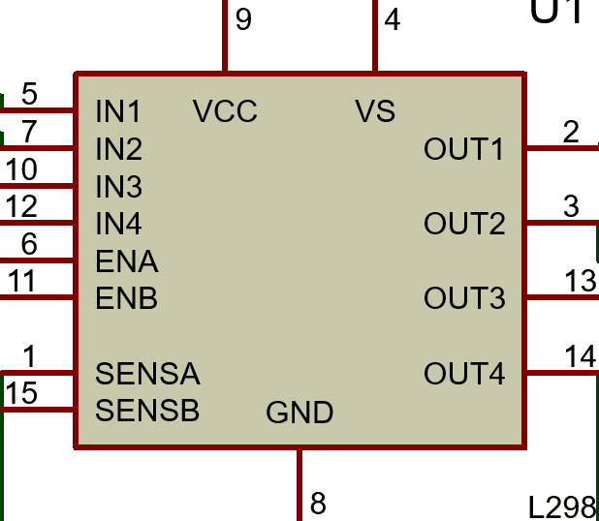
Project : EEM-16
Motor Driver
Engineering Faculty
Figure 7 : Motor Driver and Driver in Proteus

Slide 20
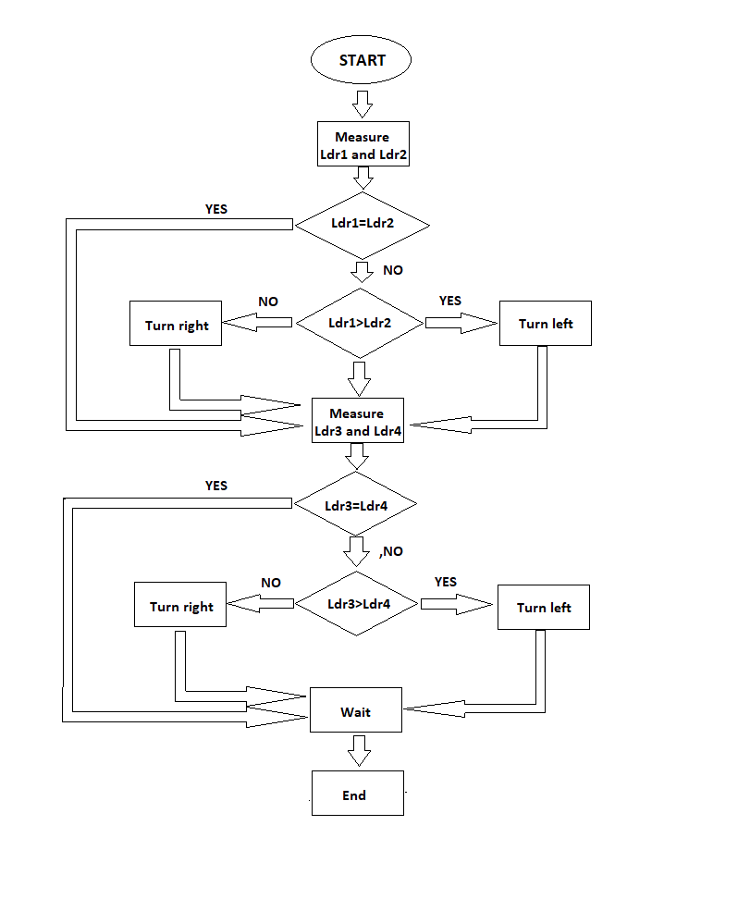
Project : EEM-16
Algorithm of Design
Engineering Faculty

Slide 21
Project : EEM-16
Results and Findings
Engineering Faculty
According to the results of the design made
The applied algorithm worked correctly.
There is no incompatibility between the equipment used.
The design can be integrated into the solar panel
The efficiency difference between them will be measured with a single axis solar panel.

Slide 22
Project : EEM-16
References
Engineering Faculty
H. Mahedi ve H. Walid Bin, “Design and Development of a Dual Axis Solar Tracker”, Department of Electrical and Electronic Engineering University of Dhaka, Dhaka, Project Report 2011-213-785, 2011.
V. S. S. Kumar, ‘Automatic Dual Axis Sun Tracking System using LDR Sensor’, International Journal of Current Engineering and Technogy, vol. 4, no. 5, pp. 3214–3217, Jan. 2011
R. Eke and A. Senturk, ‘Performance comparison of a double-axis sun tracking versus fixed PV system’, Solar Energy, vol. 86, no. 9, pp. 2665–2672, Sep. 2012
Fahmid Sadeque, ‘Design and Implementation of Automated Solar Tracking System’, 2014
Ö. BOYACI and Ç. KOCAMAN, ‘DESIGN AND IMPLEMENTATION OF REAL-TIME EMBEDDED SYSTEM-BASED SOLAR FOLLOW-UP SYSTEM USING MATLAB / SIMULINK’, ANKA e-DERGİ Journal of Phoenix (TEKNİK VE SOSYAL BİLİMLER DERGİSİ, vol. 3, no. 1, Jan. 2018
M. I. M. Rashid, M. Akorede, L. Chao, and N. F. N. Mohammed, ‘Dual-Axis Solar Tracking System for Maximum Power Production in PV Systems’, Nig. J. Technol. Dev., vol. 12, no. 2, p. 42, Feb. 2016

Slide 23
Project : EEM-16
Engineering Faculty
THANK YOU

